Slide 1

Insurance Premium Prediction
Analysis Report

Slide 2
Expenses by Gender (Male & Female):
Male
53.14%
Female
46.86%
Expenses
17.76M
23%
17%
Smoker
Smoker
Non-Smoker
Non-Smoker
51%
49%
Expenses
Insight:
Male are expenses more i.e., 53.14% compare to Female i.e., 46.86%
77%
83%
Male
Female

Slide 3
Expenses by Age Group:
50 to 60
30 to 40
20 to 30
4.47M
40 to 50
3.02M
2.68M
Above 60
Below 20
Insight:
In 50-60 years age group expense more compare to 30-40 & 20-30 years age group.
4.02M
2.42M
1.15M

Slide 4
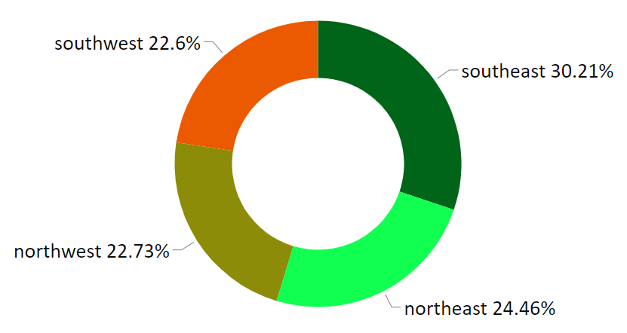
Expenses by Region:
Insight:
Almost all regions people expenses equally, but southeast compare to more, i.e., 30.21%.

Slide 5
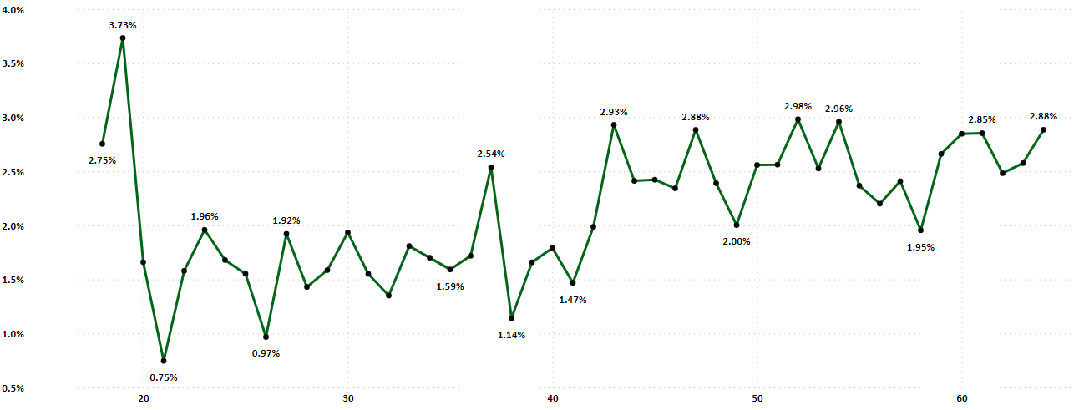
Expenses by Age:
Insight:
Age wise expenses ratio is flatulate, not an increasing order over age.

Slide 6
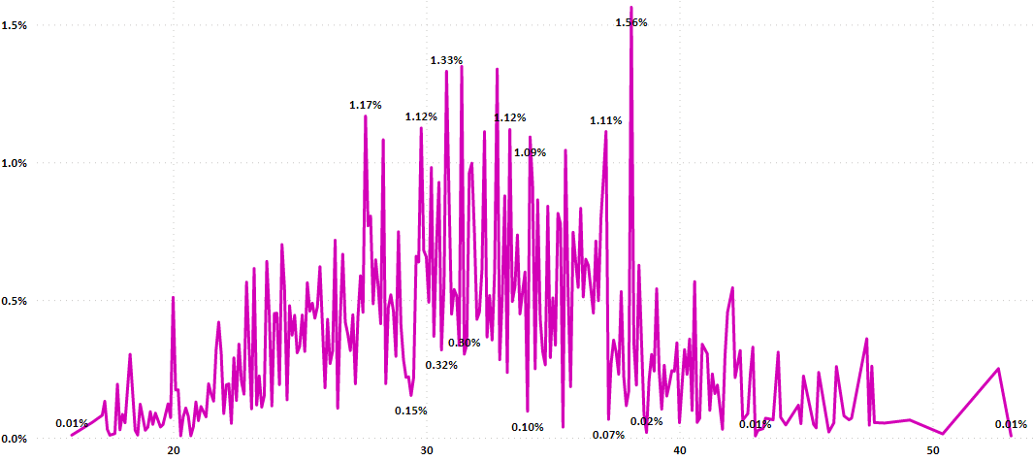
Expenses by BMI:
Insight:
BMI wise expenses ratio is flatulate, not an increasing order over bmi.

Slide 7
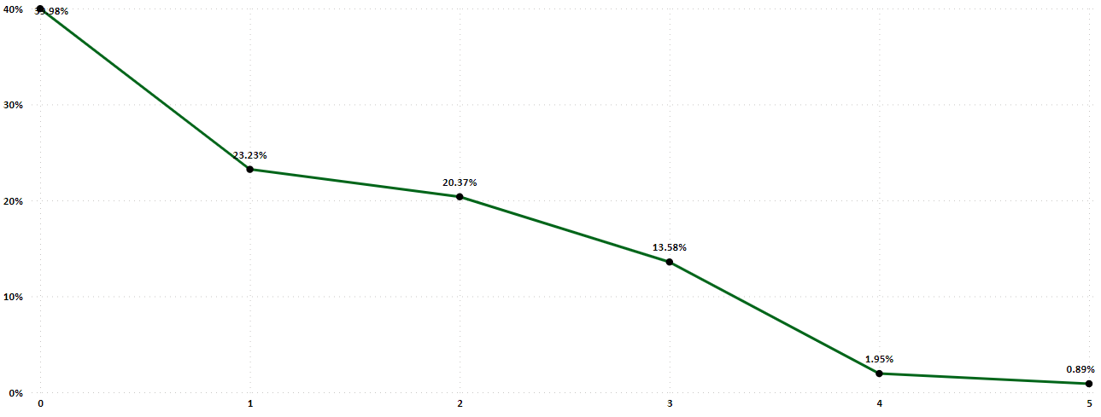
Expenses by Children:
Insight:
When number of children of a person increase then expenses also decrease.

Slide 8
Machine Learning Pipeline:
Data Collection
Understand the Business
Analyzed Data
ML Pipeline
Feature Engineering
Preprocessing
Split Data
Model Training
Model Evaluation
train
Store Data
test
Prediction

Slide 9
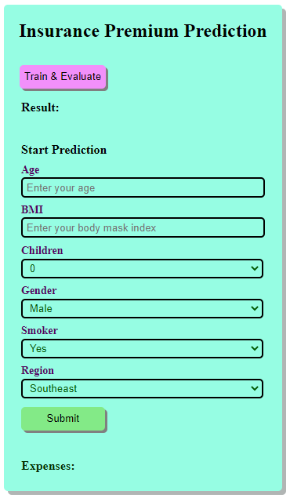
Generalized Machine Learning Model:
In this project there is no such more linear relationship between independent features and dependent feature, so we use there ML algorithms to build the model, i.e.,
RandomForestRegressor,
SupportVectorRegressor (SVR), and
GradientBoostingRegressor.
Here, we select GradientBoostingRegressor algorithm based on performance matrix. Matrix Link.
After that create a web app for predict the expenses based on new test data.

Slide 10

-by Dibyendu Biswas

